Slide 1
SOME BASIC POINTS DURING e -TENDER OF SCHEMES Under COMPONENT B WBADMIP Ph-II

Slide 2
PACKAGE CREATION AND STEP CLEARENCE
1. Create of Package – After getting Administrative Approval (AA) , decide number of package(s) following AA order. It may be one or more. During creation of packages, nearest locations should be considered.
2. Name of works – It should be as short as possible .
3. Calculation of Estimated amount Put to Tender - It should be carefully checked as per sanctioned DPR excluding contingencies for each scheme of package and then sum for getting Total Package Amount.
4. STEP Clearence – STEP package amount will be sum of the AA Amount of each scheme . Dollers Package Amount will get dividing Rs 82 .00 of Total Administrative Approval Amount.
5. STEP No – This is an unique no and preserve it .

Slide 3
DATA ENTRY IN TENDER GOOGLE SHEET -1
Sl no - Put Integer number serially starting from 1 for each Financial Year .
Financial Year - Select From Drop Down List .
Name of DPMU /Division - Select From Drop Down List
Step Package No - Type approved STEP Package No .
Name of Works - Type brief description of tender Title (It should be of short length)
Bid Reference No - Type bid reference No As per E-tender.
Type of Scheme / Non Scheme- Select From Drop Down List .
Name of the Scheme - Type Scheme Name as Approved.
Scheme Cluster No - (District/Nsc/1,2,3.. or District /Esc/1,2,3...) Type Integer No.

Slide 4
DATA ENTRY IN TENDER GOOGLE SHEET-2
Approval Status of WB - Select From Drop Down List (Yes , No, N/A)
Scheme ID - Type Scheme ID as per Administrative Approval
Administrative Approval No - Type Administrative Approval No as per Administrative Approval Copy
AA date - Enter date clicking left mouse button .
Administrative Approval (Rs) - Type Administrative Approval amount as per Administrative Approval Copy
Step Package Value (Rs)- Type Step Package Amount as approved through STEP .
Total Estimated Amount put to Tender (Rs) - Type total Amount as per tender (Integer No , without Coma) .
Individual Estimated Amount Put To Tender (Rs) - Type Individual Amount as per tender (Integer No ,without Coma) .

Slide 5
DATA ENTRY IN TENDER GOOGLE SHEET-3
District - Select From Drop Down List.
Block - Select From Drop Down List .
GP - Type as Text .
Mouza - Type as Text
JL no - Type Integer No
Plot - Type Integer No
Latitude - Type Integer No
Longitude - Type Integer No
Publishing Date of bid (on line)- Enter date clicking left mouse button
Closing Date of bid Enter date - clicking left mouse button Opening Date of Technical bid - Enter date clicking left mouse button

Slide 6
PREPARATION OF BID DOCUMENTS -1
Bid documents must be as per World Bank( WB ) standard bid documents format for particular type of scheme. Main format should not be changed put relevant Data only.
Bid documents should be prepared as per approved package.
Estimated Amount Put to Tender should not be displayed anywhere in Bid Documents as per World Bank Norms.
Bid Security – It should be @ 2 % of Estimated amount Put To Tender through NFT /RTGS or BG . Bid Security may be rounded up to the next 100 , and fixed . Validity of BG will be 45 days beyond the validity of the Bid .
Cost of Bid documents – Free .
Time of Completion of Works – It should be as per actual requirement , Generally it is considered 6 months.
Bidding Time – Minimum 30 days from date of publishing to news paper to last date of bid submission. Extra 3-4 days should be considered for publication in news paper.

Slide 7
PREPARATION OF BID DOCUMENTS -2
Last Date of Bid submission – it should be more than 10 days after bid clarification closing date.
Minimum Qualification Criteria –
1. Credential :- The bidder must satisfactorily complete at least one similar nature of work within last 3 years prior to bid opening, and having a magnitude of minimum 40 (Forty) percent of the estimated amount put to tender . (Required 40% amount have to be given in figure) .Only completion value of works , as mentioned in Completion certificate to be considered here w.r.t Credential criteria.
2. Annual Financial Turn over – The minimum amount should be 100 % of Estimated amount put to tender in any year of last 3 years. (Required amount have to be given).
3. Bank Solvency Certificate - The minimum amount should be 80 % of Estimated amount put to tender .(Required amount have to be given in figure).

Slide 8
PREPARATION OF BID DOCUMENTS - 3
The bid submitted by the bidder shall be comprised of two parts, namely , the Technical Part and the Financial Part. These two Parts shall be submitted simultaneously.
1. The Technical Part shall contain the following: -
(a) Letter of Bid – Technical Part in the format given in
Section B.
(b) Qualification information form given in Section B duly
completed.
(c) Bid Security.
(d) NIT
2. The Financial Part shall contain the following: -
Completed Bill of Quantities (BOQ).
(b) Letter of Financial Bid

Slide 9
Steps
PREPARATION OF BOQ -4
Go to the wb-tender portal “Download” section (Sl No.11) and download the BOQ template for Item rate template 4 decimals.
If Multiple schemes are in a package ,this type of Template is not available in Portal . Please use NIC approved Item rate BOQ template with multiple sheet which has shared from SPMU.
Prepare BOQ as per estimate of the DPR. All items and Qty. should be checked very carefully and check the total amount to avoid any mistakes. No estimated rate should be shown in the BOQ.
Protect the BOQ Sheet before upload.

Slide 10
OTHER IMPORTANT DOCUMENTS (OID)- 5
Sl No. | Category Name | Documents to be uploaded
A. | Certificate(s) | 1) GST Registration Certificate & 2 ) PAN 3) Latest IT Acknowledgement 4) Updated P Tax Deposit Receipt Challan 5) updated PF payment certificates. 6) updated ESI payment certificates 7) Last 3 years balance sheets from CA 8) NOC regarding litigation during last 3 years. 9) Availability of liquid assets and/or credit facilities
B. | Company Detail(s) | 1) Proprietorship Firm (Trade License). 2 )Partnership Firm (Partnership Deed, Trade License). 3 )Limited Company (Incorporation Certificate, Trade License). 4)Society (Society Registration Copy, Trade License). 5 )Power of Attorney of the signatory of the Bid to commit the Bidder.
C. | Credential | Credential will be comprised of Completion Certificate, Work order and Schedule of works as a whole. Only Payment certificate will not be considered as credential.
D. | Declaration | Bank Solvency Certificate of access to or availability of credit facilities.

Slide 11
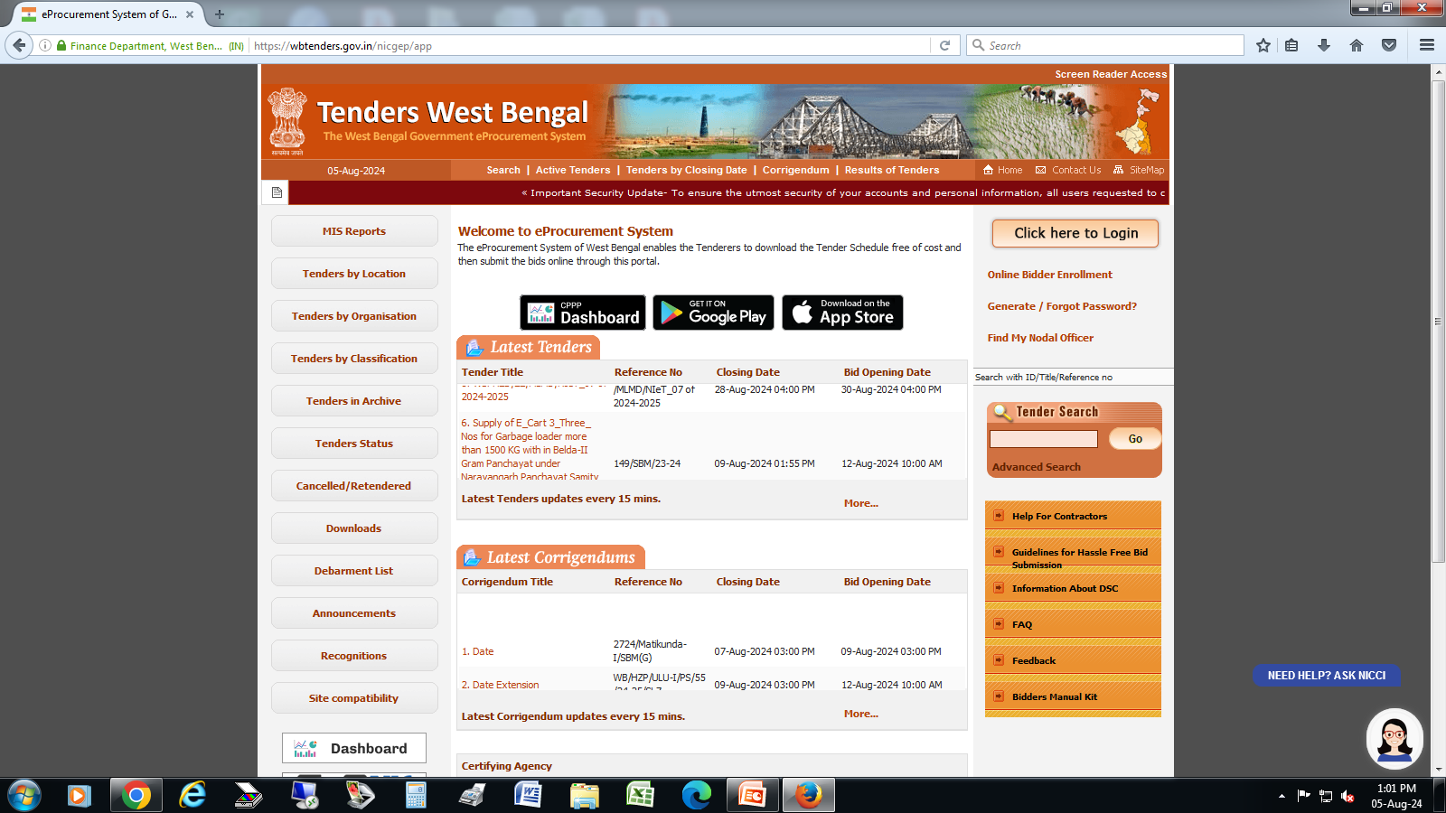
STEPS FOR CREATING TENDER IN WB GOVT. TENDER PORTAL

Slide 12
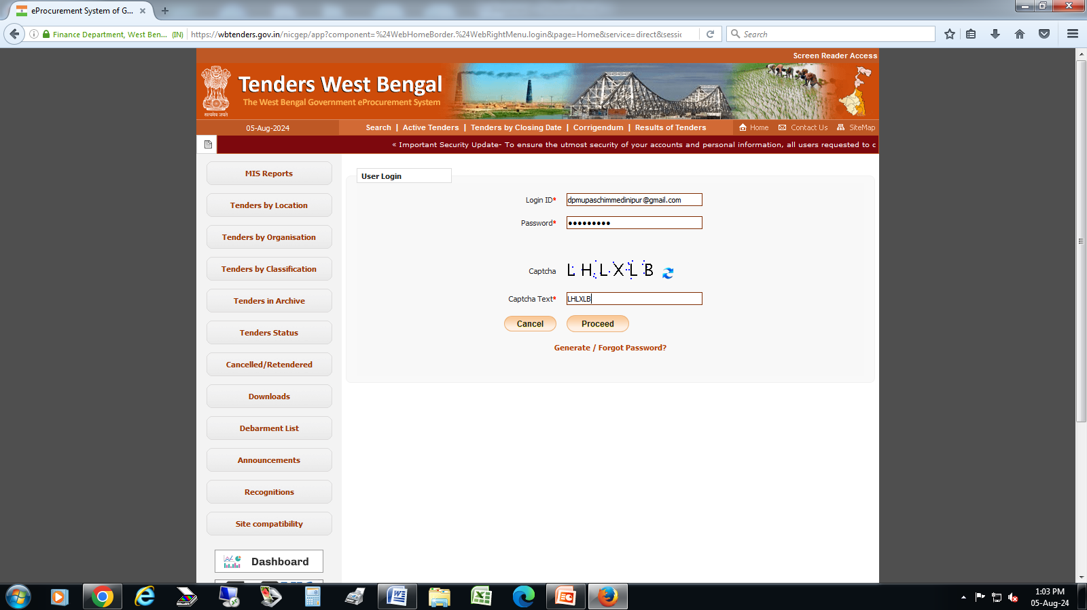
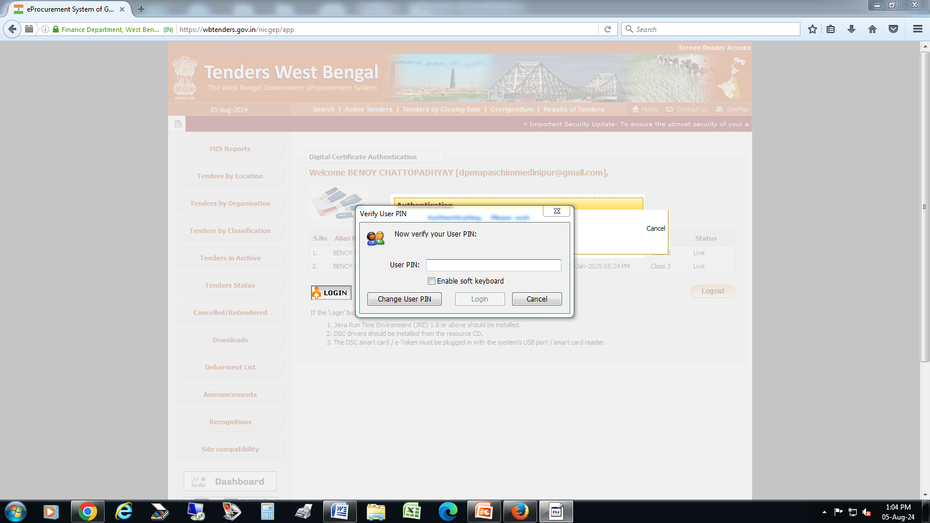
LOG - IN
Log in with Registered email id of the Tender Inviting Authority
Enter Password & Captcha
Enter DSC and Use PIN to Proceed

Slide 13
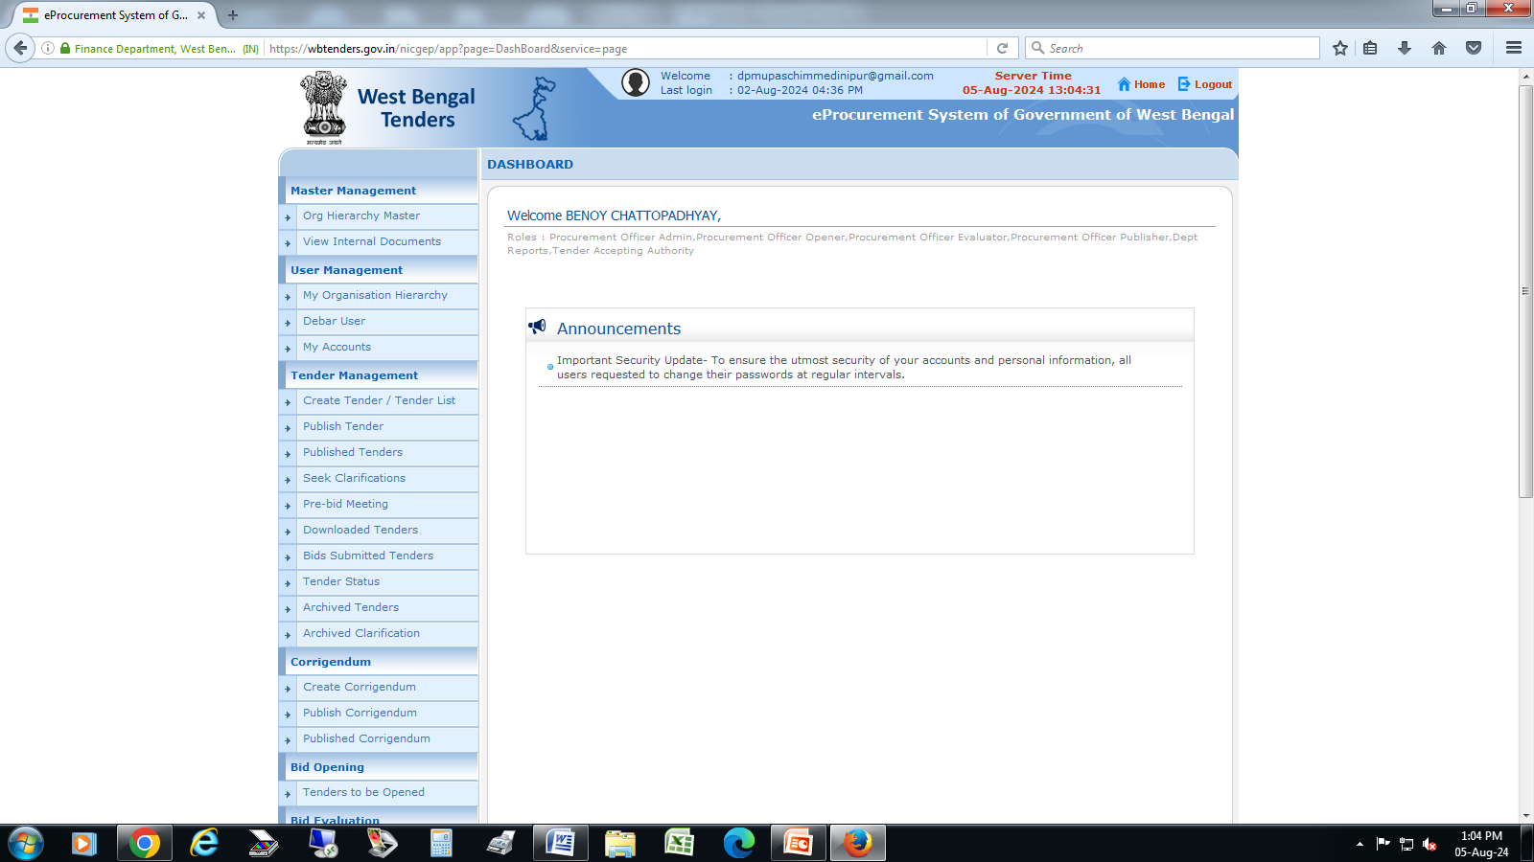
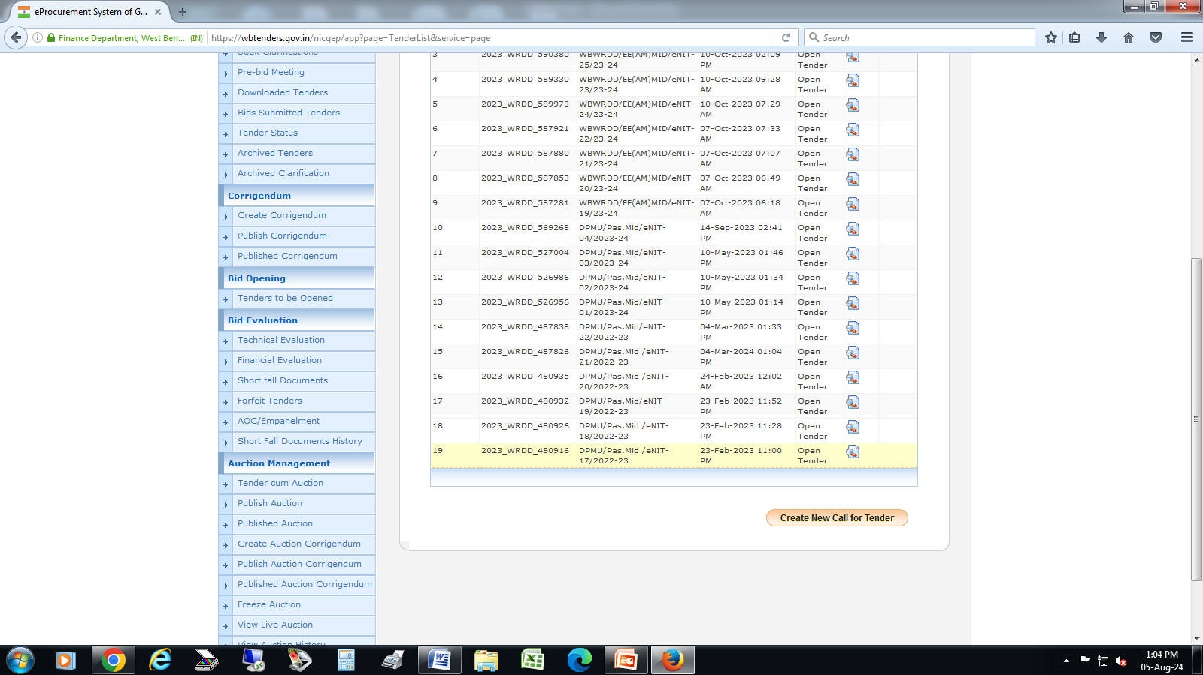
CREATE TENDER
Go to Create Tender Tab
Go to the Bottom and select “Create New Call for Tender”

Slide 14
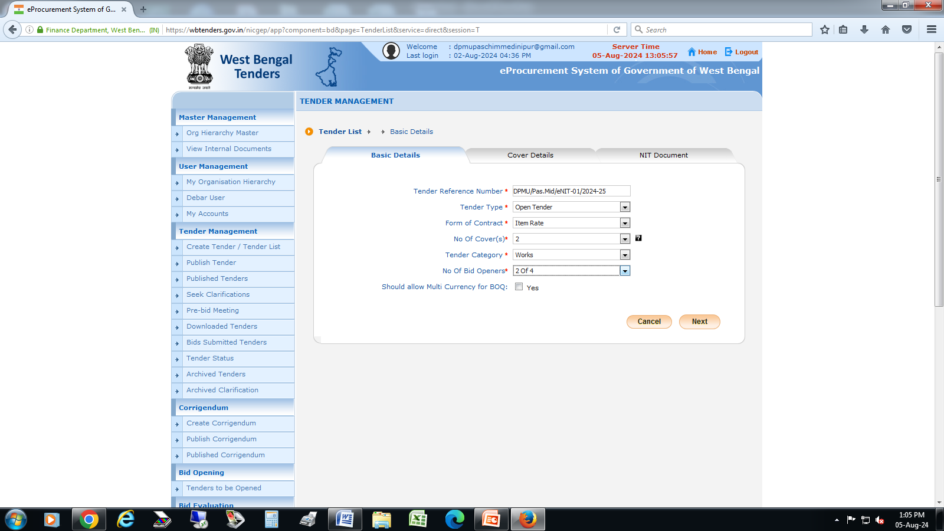
STEP – 1
BASIC DETAILS
Tender Reference Number - DPMU/Pas.Mid/eNIT-01/2024-25
Tender Type – select “Open Tender “
Form of Contract – select “Item Rate”
No. of Covers – select 2
Tender Category – select “Works”
No. of Bid Openers – select “2 of 4” or “2 of 3”
“Next”

Slide 15
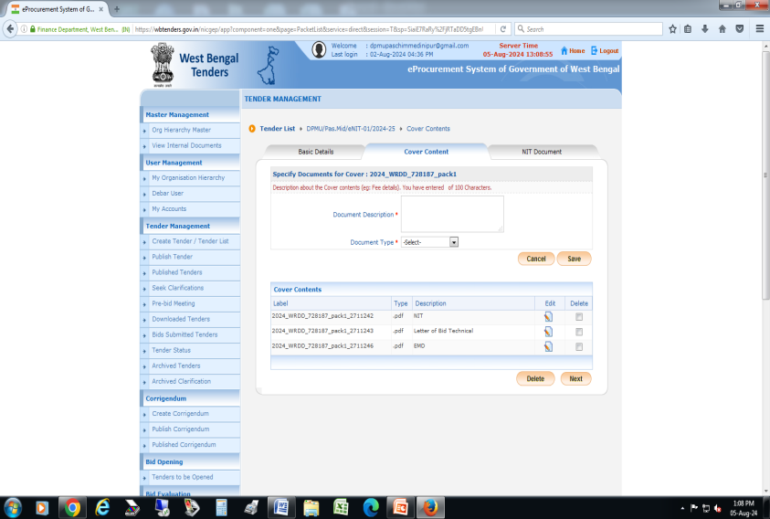

STEP – 2
COVER DETAILS
There are 2 (two) covers for this tender. (i) Technical (ii) Financial. Each cover contains some mandatory files. In this step we have to select the file types that will be uploaded by the agencies. Like .pdf and .xls format.
Select “Add Content(s)” in Technical Folder
Create 3 (Three) file types in .pdf format namely “NIT”, “EMD” and “Letter of Bid – Technical”
Then Select “Add Content(s)” in Financial Folder
Create 2(Two) file types ; .xls namely BOQ and .pdf “Letter of Bid – Financial”

Slide 16
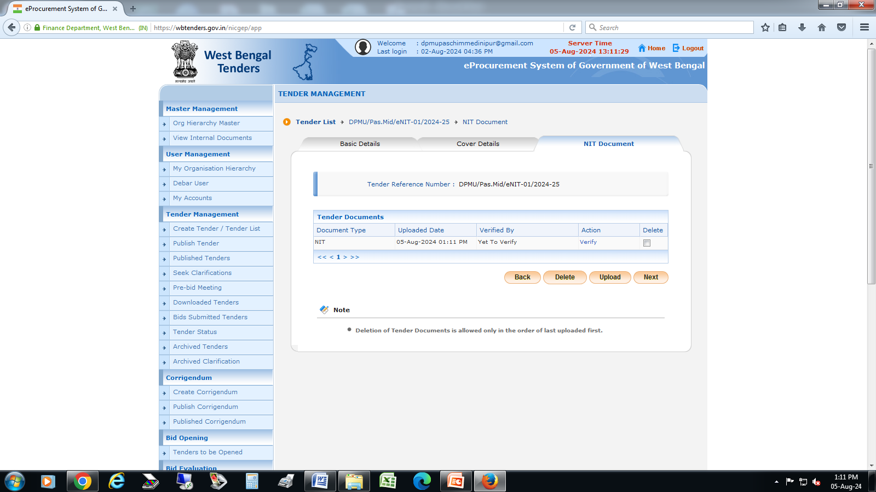
STEP – 3
NIT DOCUMENT
Upload NIT in .pdf format
Digitally signed by the TIA and Submit
Select “Verify”
After Verification click on “Next”

Slide 17
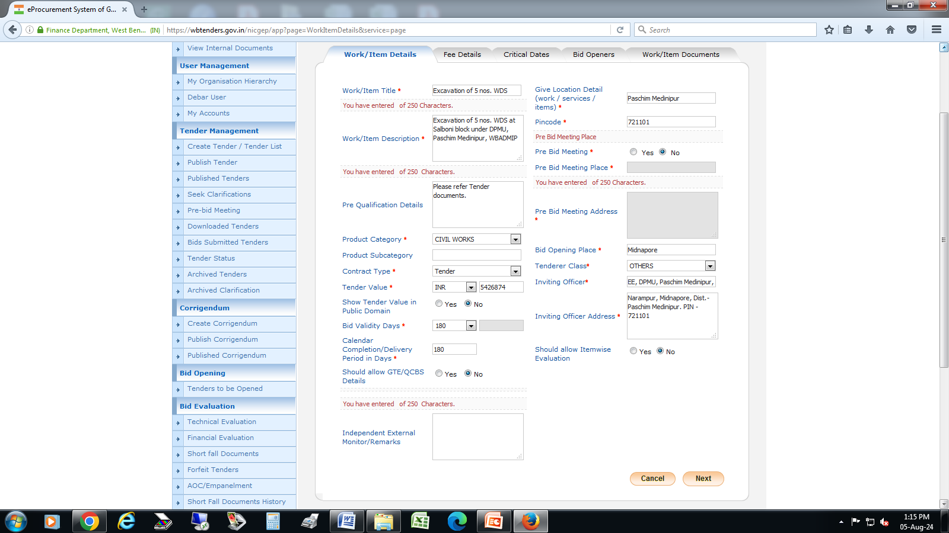
STEP – 4
WORK ITEM DETAILS
Work/Item title : Name of Work (in short within 250 characters)
Work Item Description : Name of Work (within 250 characters)
Product Category : select “CIVIL WORKS”
Contract Type : Tender
Tender Value : select “INR” & Put the Amount put to tender value in the Box
Show tender value in public domain : select “No”
Bid Validity Days : select :120”
Give Location Detail Work/ Service / Items : Paschim Medinipur
PIN code : 721101
Pre Bid Meeting : Select “No”
Bid Opening Place : Midnapore
Tenderer Class : select “Others”
Inviting Officer : EE, DPMU, Paschim Medinipur, WBADMIP
Inviting Officer Address : Narampur, Midnapore, Paschim Medinipur - 721 101
Click on “Next”

Slide 18
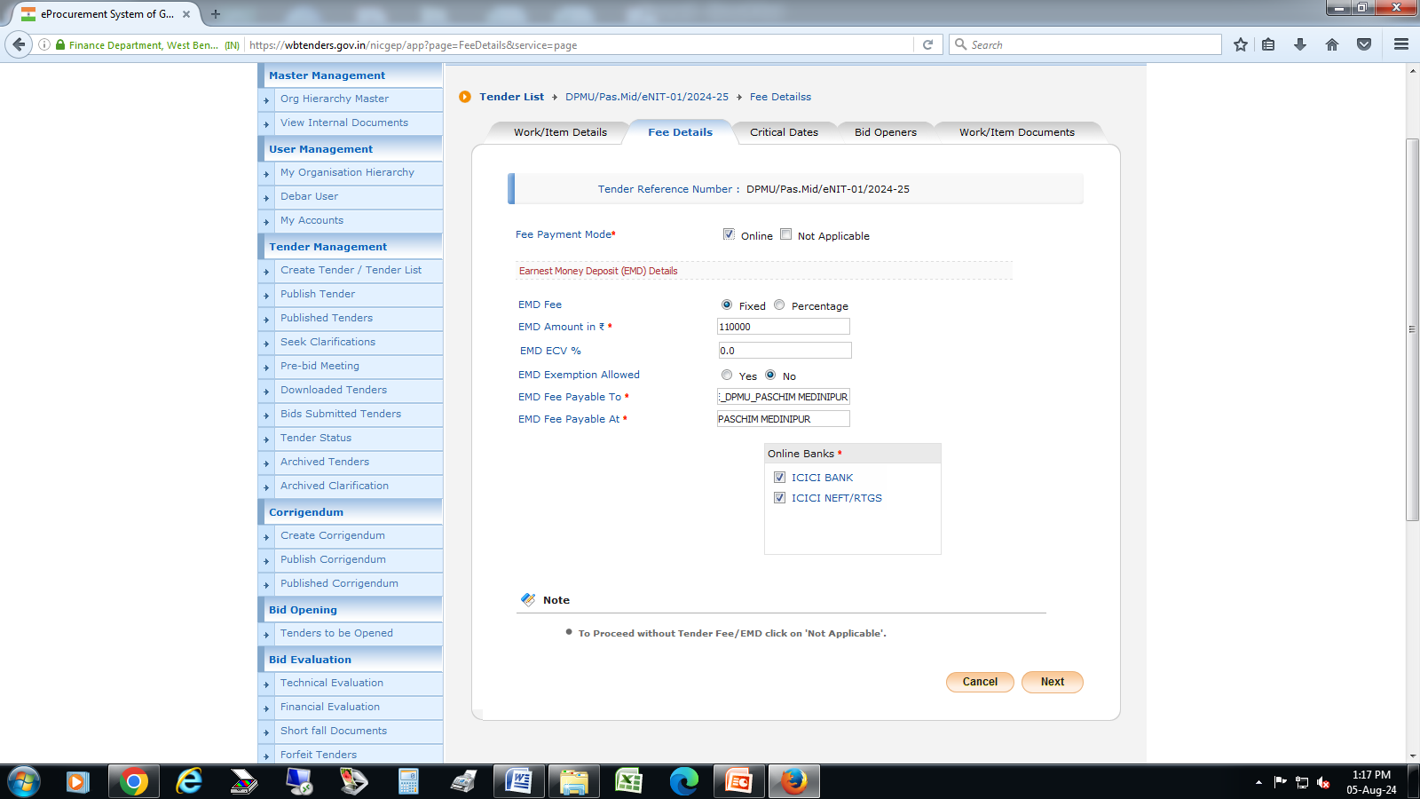
STEP – 5
FEE DETAILS
Fee Payment Mode: select “Online”
EMD Fee – Select “Fixed”
EMD Amount : Bid security Amount
EMD Exemption allowed : select “No”
EMD Fee Payable To : EE, DPMU, Paschim Medinipur
EMD Fee Payable At : Paschim Medinipur
Click on “Next”

Slide 19
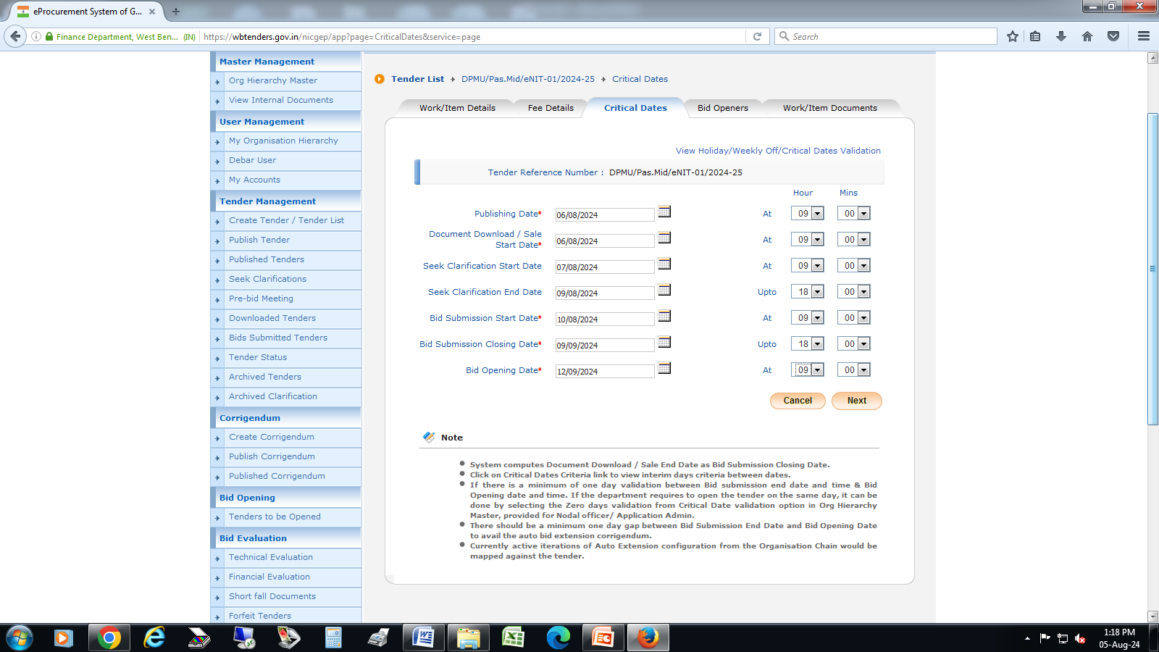
STEP – 6
CRITICAL DATES
Publishing Date:
Document Download Date:
Seek Clarification start Date:
Seek Clarification end Date:
Bid Submission Start Date :
Bid submission Closing Date :
Bid Opening Date :

Slide 20
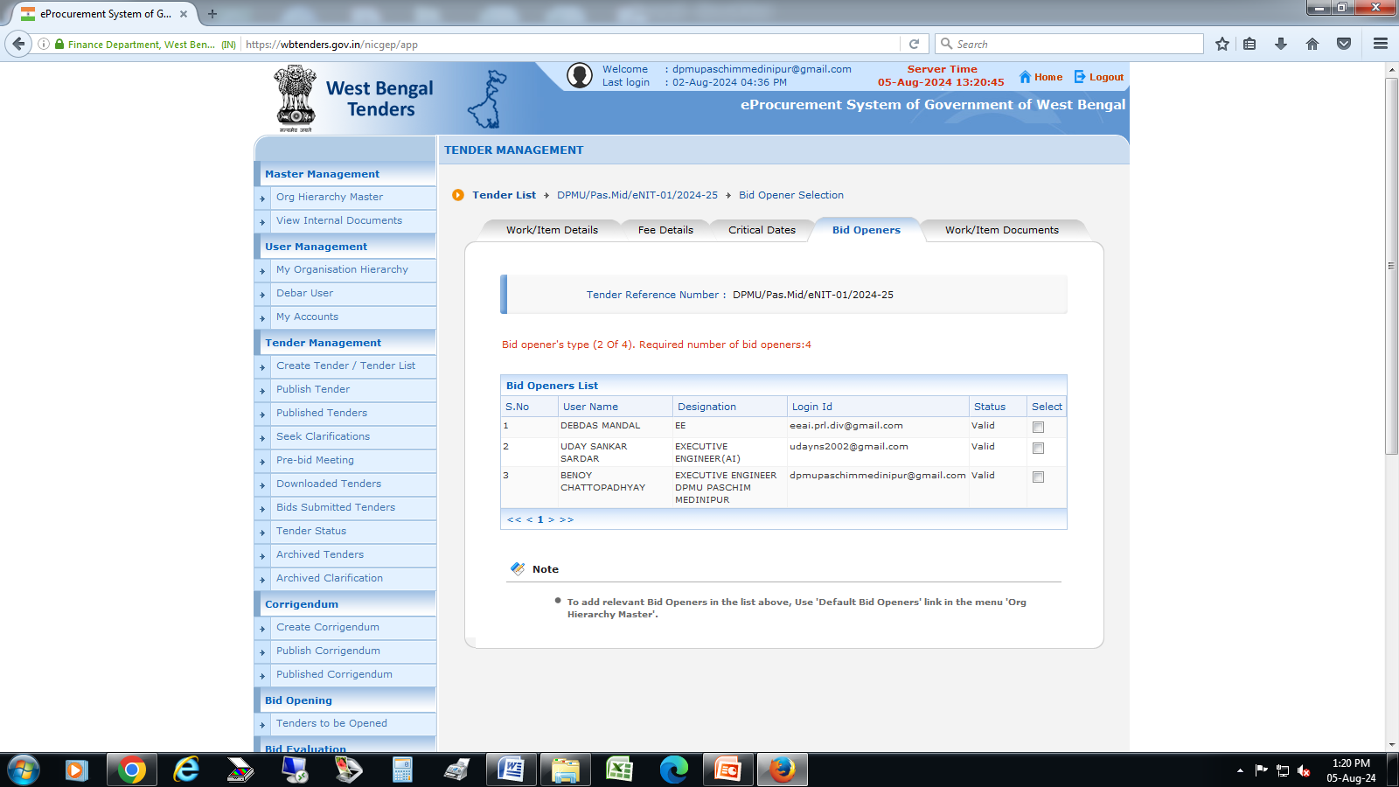
STEP – 7
BID OPENERS
Select 3 / 4 Bid Openers as per Step - 1 Basic Details.

Slide 21

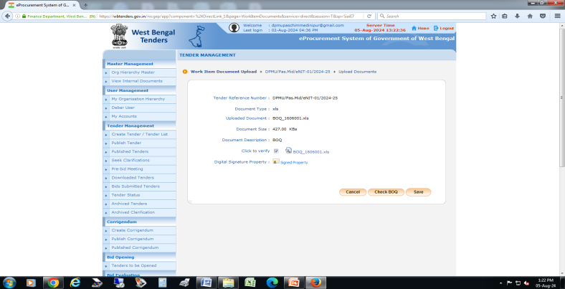
STEP – 8
WORK ITEM DOCUMENT
Click on Upload
Upload the BOQ and which is locked before uploading
After uploading, the file needs to be digitally signed then click on “Next”
Tick the “Click to Verify” box
Click on “Check BOQ”
Click on “Next”

Slide 22
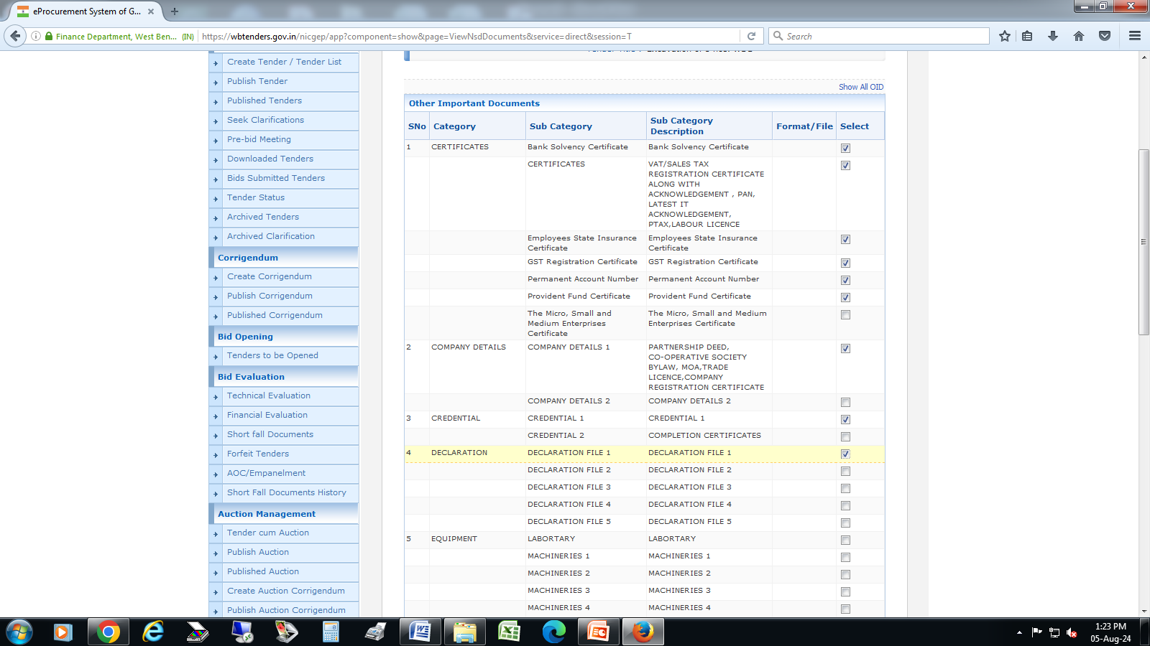
STEP – 9
OTHER IMPORTANT DOCUMENT
Click on “Show ALL OID”
Select necessary documents as per Tender clause
(i) Bank Solvency Certificate
(ii) Certificates
(iii) ESI, GST, PAN, PF
(iv) Company Details
(v) Credential
(vi) Declaration File
(vii) P/L balance sheet last 3 years
Submit

Slide 23
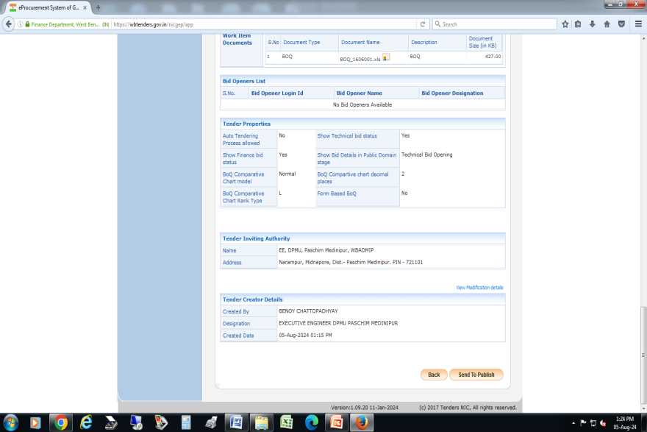
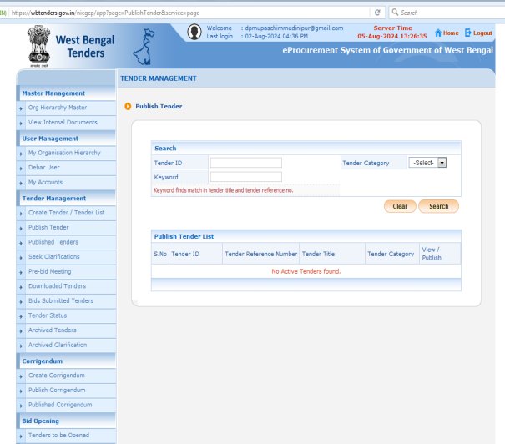
STEP – 10
PUBLISH TENDER
After submitting Other Important documents, summary of the tender will come; we have to check all dates, value , Bid Security(EMD )value etc. and then click on Send to Publish for publishing of the tender in the govt. portal.
Now, Go to the home age and select “Publish Tender”
Select the Tender and select “Publish Tender”

Slide 24
Publication of Tender in News Paper
After Publication of Tender in the portal, the tender need to publish in the news paper daily for wide circulation.
A letter to be prepared to the below mentioned address and send to advt.wridd@gmail.com mail address
To,
The Superintending Engineer (A-M),
Kolkata (A-M) Resources Circle,
Mayukh Bhawan, Bidhan Nagar,
Saltlake- 700091
Also , One attachment to be sent with the letter which will be printed in the newspaper i.e. short description of the work, bid ref no., tender ID, Last date and time of bid submission, total package value, Minimum Value of work, Maximum value of work.
GOVERNMENT OF WEST BENGAL
WRI&DD. e-NIT Executive Engineer, DPMU, Paschim Medinipur invites e-tender for Excavation of 8 nos. WDS at Keshiyari Block in the District of Paschim Medinipur under DPMU, Paschim Medinipur, WBADMI Project Phase-II, Bid reference no. DPMU/Pas.Mid/eNIT-04/2023-24, Tender ID- 2023_WRDD_569268_1, Last dropping date 13.10.2023 (upto 18:00 Hrs). Intending bidders are requested to visit the website http//wbtenders.gov.in for details. Sd/- Executive Engineer DPMU, WBADMIP, Paschim Medinipur

Slide 25
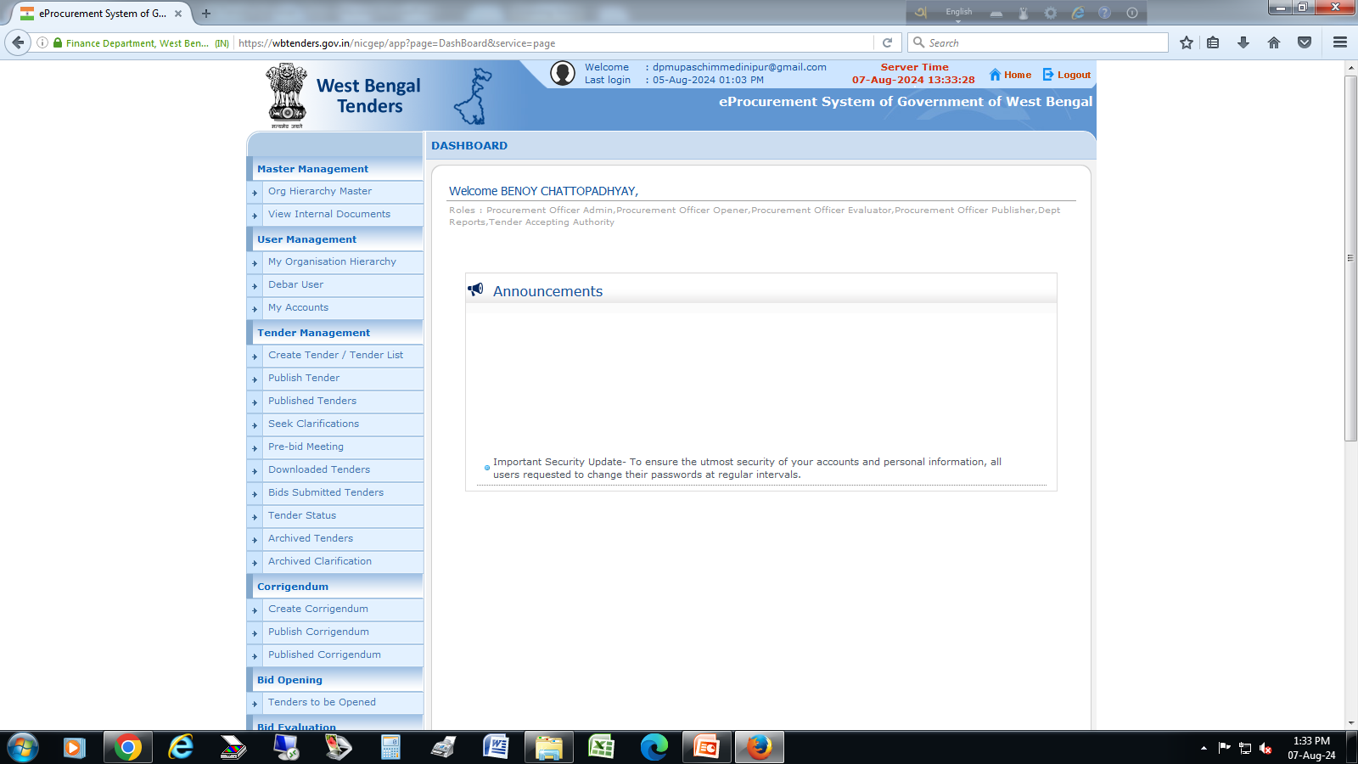
Bid Submitted
If the scheduled bid submission date and time is over, go to wb-tender portal to check how many bids are received against the tender.
Go to the “Bid Submitted tenders” and select the NIT. It will show how many bids are received. If 3 or more bids received then it is okay but if only 2 or fewer bid is received then TIA need to extend the time for 7 days or more so that more bid can be submitted maintain proper publication .

Slide 26
Technical Evaluation
On or after scheduled bid opening date and time, minimum 2 (Two) Bid openers need to open the tender in the portal using DSC.
Go to “Tenders to be Opened” section and select the NIT. After opening, download all documents submitted by the bidders and make folder for each bidder.
After checking all documents carefully “Detail Technical Evaluation Sheet” to be prepared for each NIT.
Tender Evaluation Committee meeting (chaired by DPD(Tech.)) to be arranged for final evaluation summary and proceed for Financial Evaluation. Also a short evaluation sheet to be prepare for uploading in wb-tender & STEP portal.
Date of Financial Evaluation to be decided in the meeting (7 days from the date of Technical Evaluation.
Go to wb-tender portal “Tenders to be Opened” section and submit evaluation sheet in .PDF format and proceed for “Technical Evaluation”.
Go to “Technical Evaluation” section and select the respective NIT. Now, select each bidder and select Responsive or Non-Responsive as per Evaluation sheet.
Evaluation sheet in .PDF format to be uploaded and signed by DSC of the TIA and set Financial Opening Date and Time .

Slide 27
Financial Evaluation
On or after scheduled bid opening date and time. Go to “Tenders to be Opened” section and select the NIT. After opening, download financial folder i.e. BOQ of each bidder.
Also download “BOQ Summary sheet” generated by the tender portal where Quoted rate and Ranks of each bidders (i.e. L1,L2) are specified.
Also we have to check if there is any anonymous rate for any item/items given by the L1 bidder.
Tender evaluation Committee meeting (chaired by DPD(Tech.)) to be arranged for final evaluation summary and proceed for AOC/ recommendation for work order.
Go to wb-tender portal “Tenders to be Opened” section and submit evaluation sheet in .PDF format and proceed for “Financial Evaluation”.
Go to “Financial Evaluation” section and select the respective NIT. Now, select each bidder and put their quoted rates and ranks.
Evaluation sheet in .PDF format to be uploaded and signed by DSC of the TIA and proceed for AOC.

Slide 28
Award of contract (AOC)
After Agreement with the Agency and submission of the Performance Security, Go to “AOC” section of the wb-tender portal.
Select the NIT and proceed.
Contract Amount : Put “Work Order” value
Description : Work Order
Set Work Order date in the calendar.
Now reason for AOC to be written beside L1 bidder box
Tick the L1 bidder and final submit for AOC.

Slide 29
deposit & release of PERFORMANCE SECURITY
Deposit :- Within 15 days of receiving letter of acceptance, the successful bidder shall deliver to the Executive Engineer (Employer) the performance security (either a bank guarantee or a bank draft in favor of the Employer) for an amount equivalent of 3% of the contract price. The Performance Security shall be valid until a date 28 days after the date of issue of the Certificate of Completion. Failure of the successful Bidder to furnish performance security and sign the agreement within the period stipulated shall constitute sufficient grounds for annulment of award and forfeiture of the Bid Security, in which case the Employer may make the award to the Bidder offering the next Most Advantageous Bid or issue a new RFB.
Release : - The Performance Security will be discharged after completion of Works .

Slide 30
Deduction & release of retention money
Retention :- The Employer shall retain (Retention Money) 6% of the amount from each payment to the Contractor .
Release :- Half of the amount retained shall be repaid upon completion of the works, and other half shall be repaid when the Defects Liability Period has passed and the Engineer has certified that all Defects notified to the Contractor before the end of this period have been corrected for the Works of CD, Jhora WMS, WDS Canal and WDS.
For Brick PDW Solar, Ring PDW Solar and Solar TW , 6% Retention money will be released after One Year successful operation of Works Part. (Defect liability Period) and 6% Retention money will be released after One Year successful operation of Solar Panels (Defect liability Period)
.

Slide 31
defect liability period and comprehensive maintenance
Defects Liability Period :- The “Defects Liability Period” for the work is 12 (Twelve) months from the date of taking over possession or one full monsoon season whichever occurs later. During this period, the contractor will be responsible for rectifying any defects in construction free of cost to the Employer.
Comprehensive maintenance :- The solar operated schemes such as TW (Solar), PDW (Solar) and Solar Pump Installation have 5 yrs. Comprehensive maintenance .

Slide 32
TENDER REGISTERS
Minimum 5 Nos. Registers to be maintained for procurement related works:
1) Bid Security money deposit and released Register
2) Scheme Cluster Register.
3) NIT Register
4) Agreement Register
5) Bid Evaluation Register

Slide 33
BID SECURITY Money Deposit Register
Bid security Money deposited by bidders are automatically revert back to them by the system except the L1 bidder.
After Agreement and submitting Performance Security, the L1 bidder has to submit a request letter to the Executive Engineer, DPMU for release of EMD.
Now, the EMD amount will be transferred to Head Of Account “8443-00-108-004-07” by the DPMU office from Grieves challan submitted by the Agencies.
Once the EMD amount is transferred to the above mentioned head of account, the EMD amount will be transferred directly to the beneficiary account from Head of Account “00-8443-00-108-00-004-23-00-0” by the DPMU.
Sl. No. | Name of Agency | Bill No. & Date | Challan/TV No. | Opening Balance | Credit | Total | Debit | Closing Balance

Slide 34
NIT Register
Sl No. | Name of Work/Supply | STEP No | Estimated Cost (Rs.) | Amount Put to Tender (Rs.) & Bid Security (Rs.) | Bid Reference No. | NIT/NIQ Memo No. & Date | Bid Submission end Date & Time | Bid Opening Date & Time | Tendering Authority | Remarks
1
2
3

Slide 35
Agreement Register
Sl No. | Name of Work/ Supply | Bid Reference No. & Tender ID | STEP No | Amount Put to Tender (Rs.) | Agency details | Work Order Memo No. & Date | Performance Security Details | Completion Time | Contract Value (in Rs.) | Remarks
1
2
3

Slide 36
THANK you

